Slide 1
Score Maximization with Momentum + RSI + Bollinger Bands
By: Hayagreev Dilip

Slide 2
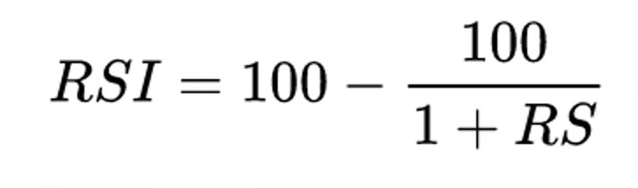
Goal
Target oversold stocks that have strong long term growth
- RSI + Bollinger Bands for identifying oversold stocks
- 200 day and 50 day moving averages for determining historical performance of stock (momentum aspect)
- 40% of score is momentum score, 30% is RSI score, 30% is Bollinger score
RS = Average Gain / Average Loss

Slide 3
Implementation
- Consider stocks from ['AAPL', 'MSFT', 'GOOG', 'AMZN', 'NVDA', 'TSLA', 'META', 'TSM', 'V']
- Portfolio consists of these stocks and gives them a ranking each day
- Keep the stocks with the highest score in our portfolio, sell stock with least score in portfolio to get money for the trade (only do this if the stock ot be added has a higher score than the stock to be removed)
- Diversification: Only buy 15000 to 20000 of any particular stock

Slide 4
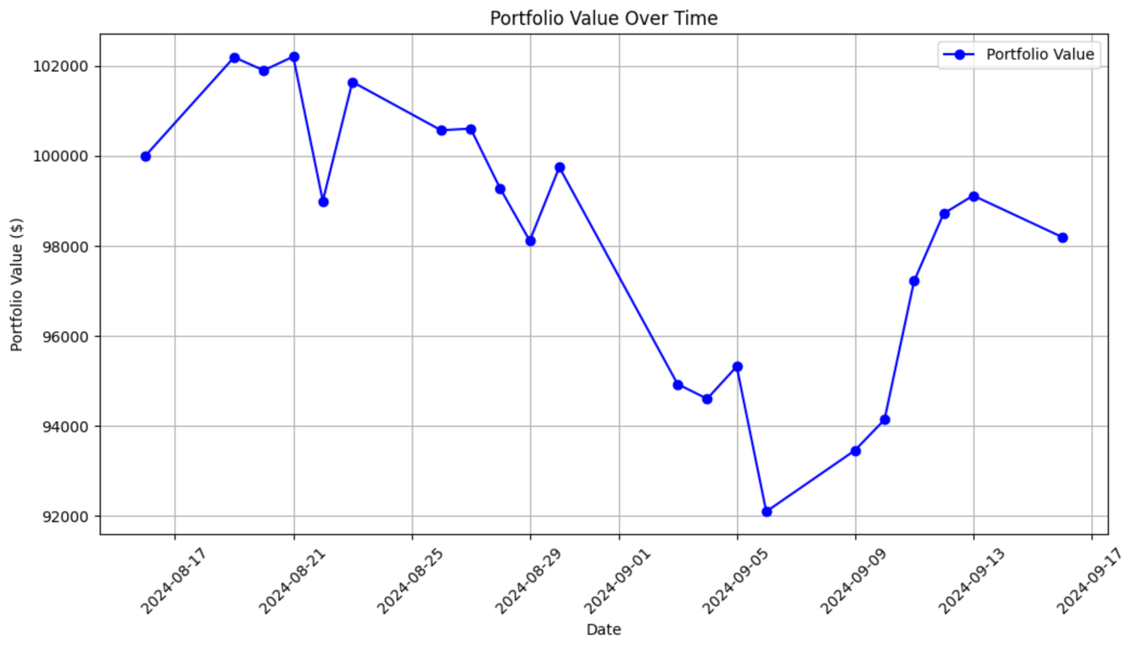
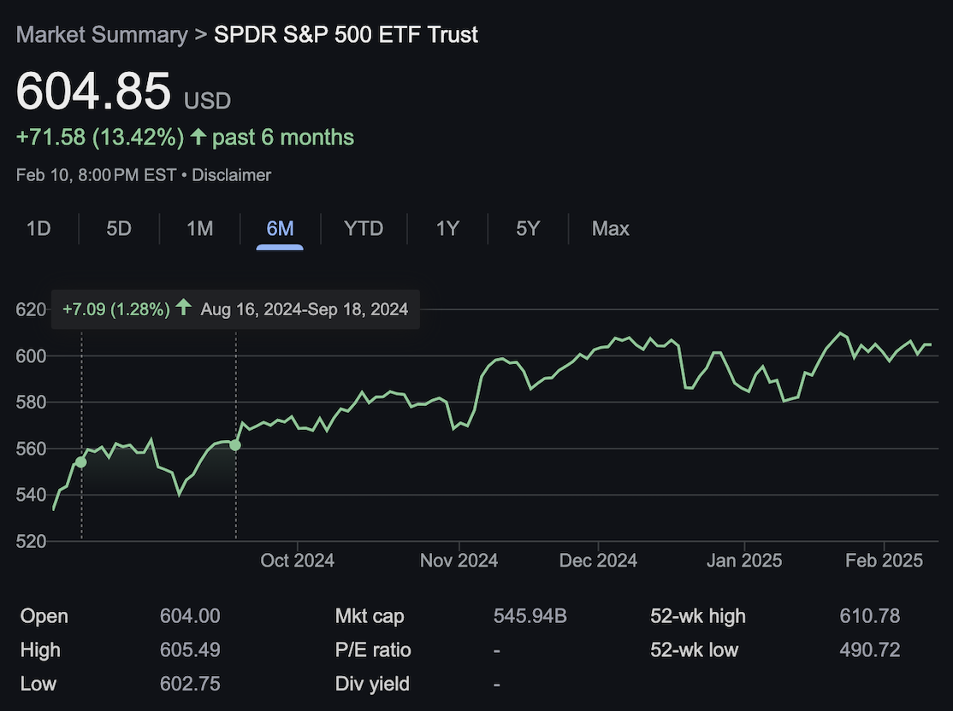
Performance

